Slide 1
Digital Governance/e-Society
All citizen’s data will be stored in Central Database.
Each citizen can change some of their data.
User can get access into their information through state portal.
Save once (birth-info, medical-info, bank-info) and access
many times and anywhere
User’s data can be accessed by any related state agency.

Slide 2



Digital Governance/e-Society
Public Organization
Private Organization
Bank
Passport
Police
Hospital
Job
Hospital
Education
Education
Bank
Paying Tax
Election
Citizen Database

Slide 3
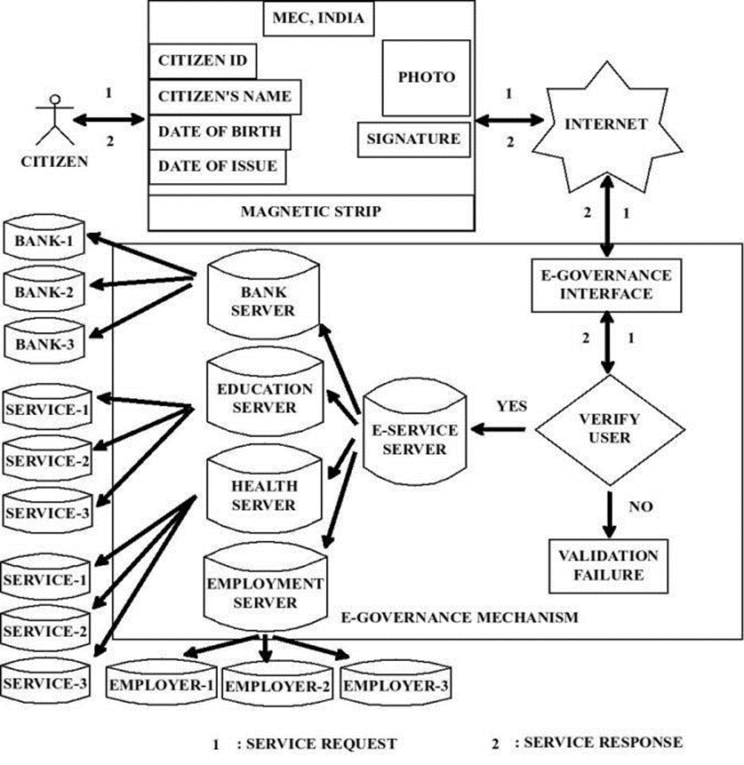

Slide 4

Tasks to be implemented (Health Sector)
Citizen can explore their previous medical record through state portal.
Lab Professionals can store patient report in state portal through medical portal.
Doctors can also store prescription for respective patient through their medical portal and see patients previous medical record depending.
Citizen can register in state Portal.
Doctors will not be able to see all record accept the concerned one.
Web
Interface
Send Credentials
Medical Information System
Doctor Portal
Citizen Information System
Citizen Portal
Retrieve History
Lab Portal
Send Credentials

Slide 5
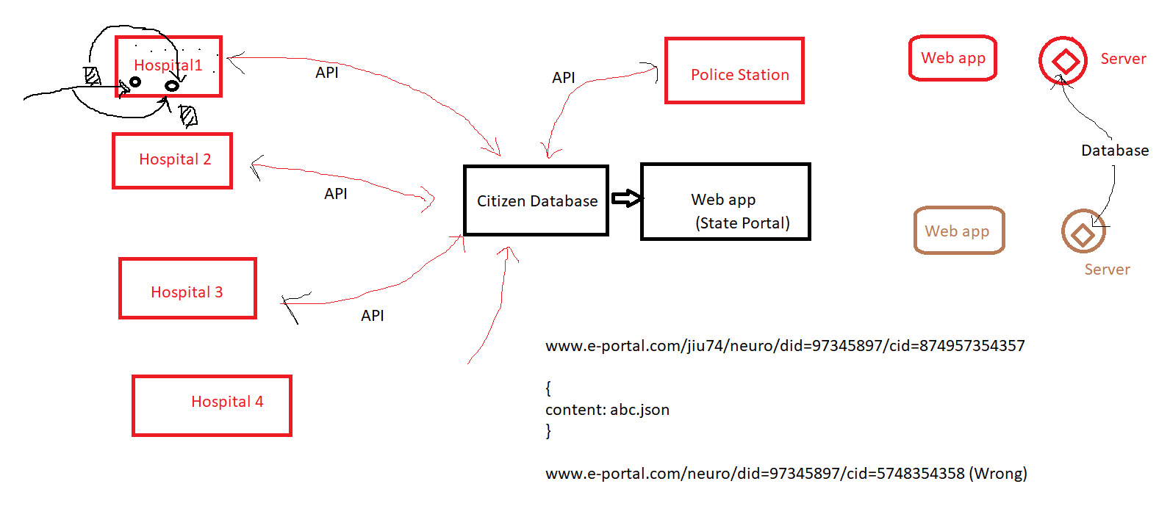

Slide 6
Hospital Portal
Doctor Interface
Patient’s Medical History
Patient’s Medical Portal
NID
Patient info (login)
Prev. History
DOB
Pass
Doc. Upload
Reg.
Lab Official’s Interface
Patient’s Medical Portal
Patient info (login)
Doc. Upload
Doctor Reg
Citizen Reg
Citizen Portal
Dashboard
Medical Services
Medical History
NID
DOB
Service Menu
OTP
Services (Menu)
Reg.

Slide 7
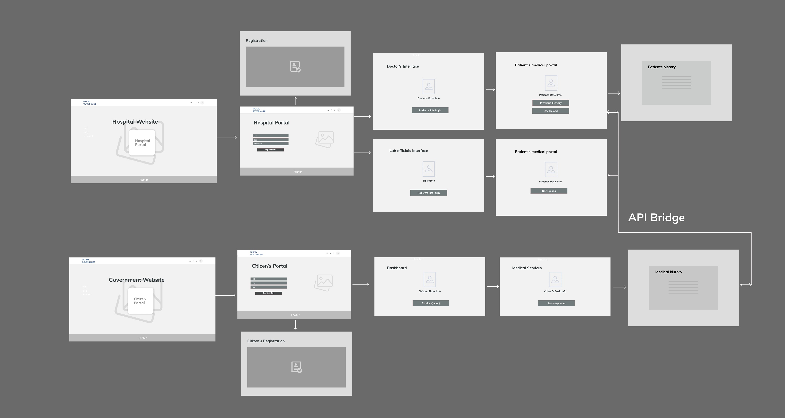

Slide 8
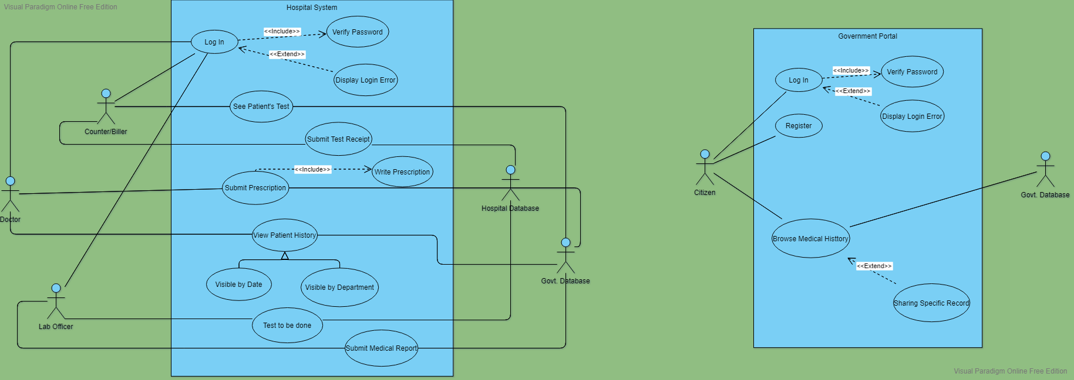

Slide 9
Doctor
Doctor
Patient Bio
Prescription Form
History
Biller
ID
Patient Bio
Diagnosis Info
Pass
Registration for Test
Log In
Lab officer
Patient Bio
Diagnosis Info
File input

